Slide 1
Cooking Manual
Cody murrer
Cis 106-2
May 16 2018

Slide 2
Summary
Start on a home menu.
Can select from entry, search, how to, exit.
When selecting a button the frames will change .
After changing frames you can input data or search for the data.
Notes:
The program starts on a home screen with a few navigation items that takes the user to its desired location within beta currently only the exit and entry button is functional. When selecting entry the screen size and contents change to 3 text fields and two buttons.

Slide 3
Input
There are 4 buttons within the main screen as a navigation
Each screen either has a button or text fields used to store, return, or search for data
The text fields are used to search and store the data
The buttons are mostly used for navigation purposes
Notes:
There are 4 buttons on the main menu that serve the purpose of navigation. Each screen will have some type of input ranging between text fields and buttons. On the entry and search screens there will be between 1-3 initial text boxes that will request data in order to proceed through the program.

Slide 4
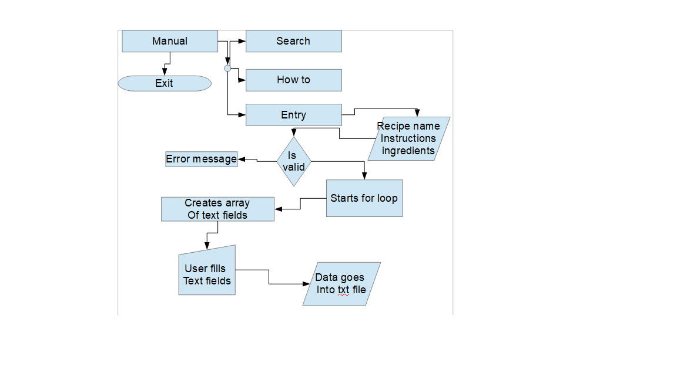
Hierarchy
Manual control menu to 4 different buttons
Entry button goes to the recipe entry page
Then asks for specific data
That data gets validated and runs into a loop
Notes:
The manual is essentially a home menu that lets the user go where they please. Entry takes the input of the recipe name how many ingredients and instructions there are to help fill out an array that will be present on screen after the method is called by clicking the continue button then once the array Is on screen enter the data and hit submit.

Slide 5
Processing
If statement validates data then if valid stores it into a for loop.
Once loop is initiated it will run through the array of inputs.
Then store it into the txt file using a file writer.
Notes:
Once the data had been inputted within the starting text fields a button will validate the data and begin a for loop creating the exact amount of text fields that are needed. The data then will be submitted with the help of another button that will then send the data to a file writer which will store all the data.

Slide 6
output
A label array will get filled with requested data.
The array will print onto the screen into labels.
Showing the data requested.
Notes:
When searching for the recipe wanted the user can use a text field to search the txt document by using a file reader accompanied with a buffer reader to find that instance of text within the document. Once found the file reader will begin to populate an array of labels to then print onto the screen.

Slide 7
Data model
Notes:
This is an example of how the text field array would work when storing the data within the txt file it will get the index number and name then add together the two integers that follow and create that many new lines in the document that gets filled with the string variables within the text fields

